Slide 1

Paper Presentation
on
Image text to braille
Presenters
Nithyakalyani B
Sathya Keerthana M
Swarubini PJ
BE-BioMedical
Second Year
CEG, Anna University

Slide 2
objective
Braille is a tactile writing system used by the visually impaired people.
It is traditionally written with embossed paper.
Visually impaired people can read Braille only through touch.
This Braille system converts the Text image to Braille code.
The Braille output message can be read by just feeling the push-pull action of the solenoids.

Slide 3
introduction
New technological enhancement Braille system is of higher cost and less portability.
The Image text to Braille converter is low cost, moveable and fast Braille system.
The Braille code for a letter, number or any punctuation is a cell comprising six raised dots.
This Paper aims at replacing the raised dots with solenoids for better usage.

Slide 4
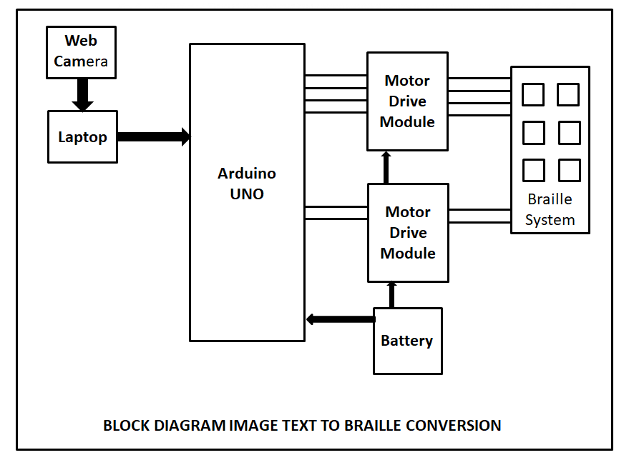
Block diagram

Slide 5
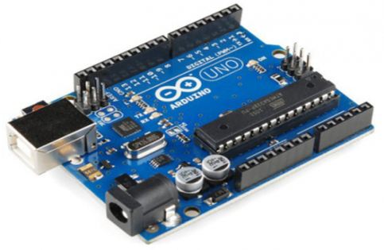
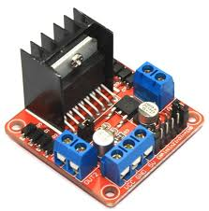
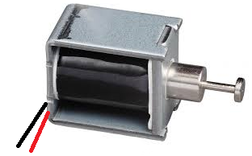
Components description
ARDUINO UNO - It is a microcontroller board based on the ATmega328p. It has 20 digital input/output pins.
MOTOR DRIVE MODULE L298N – It is a dual H-Bridge motor driver which can control the speed and direction of two DC motors at the same time
SOLENOIDS - It is used to convert electrical to mechanical energy, as in the operation of a switch

Slide 6
Proposed system design
The image consisting of text is captured using a web camera.
The captured image is applied to the image pre-processing where the undesired noise is removed by applying suitable threshold value.
The captured Image is rescaled to an appropriate size and it is convert to gray scale image which is again converted to binary image.
After pre-processing, the text in the image is converted and stored in a .txt file using OCR programming.
Cont.

Slide 7
Proposed system design
The stored text in the .txt file is fed sequentially to the Arduino UNO by USB cable via the serial communication ports.
Each character is thus recognized by the Arduino UNO. After recognition the solenoids are triggered for push action by motor drive module.
The protruded pin from the original position of the solenoids provides the tactile feedback to the visually challenged people who can recognize each character .

Slide 8
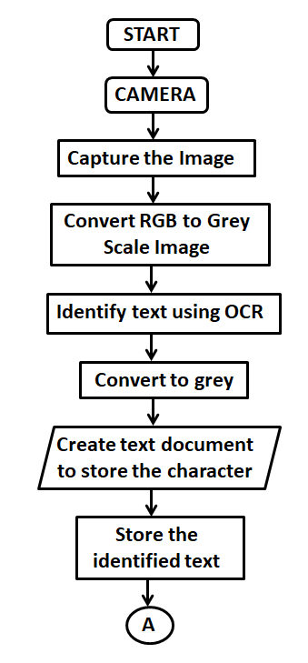
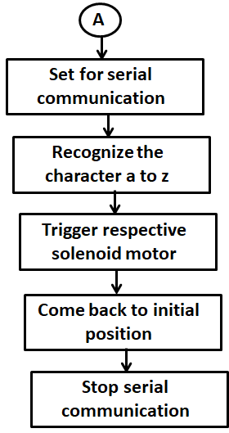
Proposed system design
Flow Chart for Image Text to Braille conversion

Slide 9
Proposed system design
Six solenoids are used to represent the six dots and due to the Push-pull action one can recognize the push action as a raised dot.
Two motor drive modules L298N are used to drive the six solenoids,
A 12V DC battery is used to power up the solenoids and the Motor drive modules.
All the grounds are connected to a common ground.

Slide 10
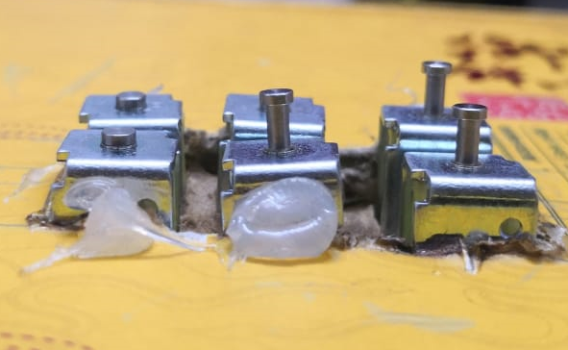
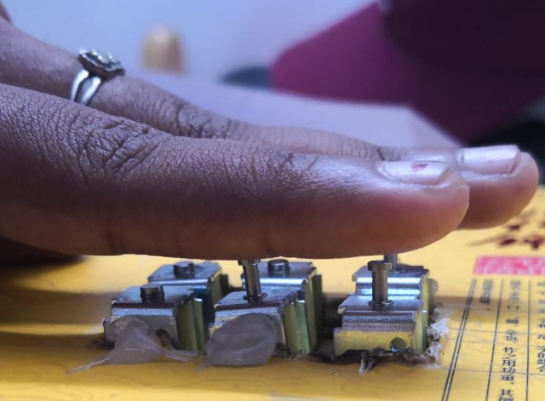
Result
From this paper presentation we have obtained the following outcomes. When an Input Text image is given ass D, the output that is obtained is shown in Fig.7 and Fig.8.
Fig 7.Solenoid projection for a given input text D
Fig.8 The solenoid projection being felt by touch

Slide 11
CONCLUSION
This Braille system aims to develop cost-effective assistive technologies to provide visually impaired people with a greater degree of independence in their day to day activities and during their navigation.

Slide 12
FUTURE SCOPE
This can be expanded to an image text to audio output so that the visually impaired people can hear the text message through a speaker.
This can be further expanded to reading images like sign boards, directional arrows and numerals by suitably pre-defining in the software.

Slide 13
references
R. Shylaja International Journal of Electronics, Electrical and Computational System, IJEECS, ISSN 2348-117X Volume 7, Issue 5, May 2018
Ebnet, Matthew (2001), "Braille Challenge Gives Young Blind Students a Chance to Shine", Los Angeles Times, 16960, retrieved 2009-04-15.

Slide 14

THANK YOU

